Slide 1
Numerical variables
Natalia Levshina
Jena WiSe 2017

Slide 2
Outline
Measures of central tendency
Measures of dispersion
Graphical representations
Testing normality

Slide 3
Data frame ldt
> head(ldt) # returns the first 6 rows
Length Freq Mean_RT
marveled 8 131 819.19
persuaders 10 82 977.63
midmost 7 0 908.22
crutch 6 592 766.30
resuspension 12 2 1125.42
efflorescent 12 9 948.33

Slide 4
Data frame structure
> str(ldt) # displays the structure
'data.frame': 100 obs. of 3 variables:
$ Length : int 8 10 7 6 12 12 3 11 11 5 ...
$ Freq : int 131 82 0 592 2 9 14013 15 48 290 ...
$ Mean_RT: num 819 978 908 766 1125 ...

Slide 5
Attach a data frame
> head(ldt$Length)
[1] 8 10 7 6 12 12
> head(Length)
Error in head(Length) : object 'Length' not found
> attach(ldt)
> head(Length) #now you can access all variables directly
[1] 8 10 7 6 12 12

Slide 6
Mean, median and mode
> mean(Length)
[1] 8.23
> median(Length)
[1] 8
> table(Length) #shows how many times every value occurs; the most popular value is the mode
3 4 5 6 7 8 9 10 11 12 13 14 15
2 5 7 13 12 16 11 16 11 3 1 2 1

Slide 7
Understanding the median

Slide 8
Ocean’s 11: the median

Slide 9
Ocean’s 12

Slide 10
Ocean’s 12: the median

Slide 11
Mean vs. median
In some situations the median gives a better idea of the most typical value than the mean. The problem with the latter is that it is easily influenced by outliers, i.e. scores with unusually high or low values.
For example, if twenty employees in a company have net salaries of €2000 a month, and the CEO’s salary is €50000, the mean salary will be €4286, and the median will be €2000. The median gives a more realistic idea of the salaries in the company than the mean because the CEO’s salary is exceptional.

Slide 12
Exercise
Find the mean and the median of the reaction times in ldt.

Slide 13
A very useful function summary()
> summary(Mean_RT)
Min. 1st Qu. Median Mean 3rd Qu. Max.
564.2 713.1 784.9 808.3 905.2 1458.8

Slide 14
Outline
Measures of central tendency
Measures of dispersion
Graphical representation
Testing normality

Slide 15
Measures of dispersion
> range(Length) # the minimum and the maximum
[1] 3 15
> var(Length) #variance = sum of squared deviations [1] 6.259697 from the mean, divided by the number of observations - 1
> sd(Length) # standard deviation = the squared root [1] 2.501939 of variance

Slide 16
Why care about the dispersion?
Consider two countries with a similar average income per capita. In one country the variance and standard deviation are relatively small because the finances are distributed fairly, whereas in the other they are very large because of several billionaires and many extremely poor people. Although the means are identical, life in the two countries will differ dramatically.

Slide 17
Statisticians make jokes, too ☺
If your head is in the oven, and your feet are in the fridge, on average you're quite comfortable.
Image from moneymarketing.co.uk

Slide 18
Outline
Measures of central tendency
Measures of dispersion
Graphical representations
Testing normality

Slide 19
Boxplot
> boxplot(Mean_RT)
A bit more sophisticated:
> boxplot(Mean_RT, main = "Mean reaction times", ylab = "reaction time in ms")

Slide 20
Box-and-whisker plot
Outliers (more that 1.5 times IQR)
Upper whisker: max.1.5 times IQR from the upper hinge
Upper hinge: 3rd quartile, or 75%
Median (or the 2nd quartile, or 50%)
Lower hinge: the 1st quartile, or first 25%
Lower whisker: max. 1.5 times IQR from the lower hinge

Slide 21
Boxplot stats
> boxplot.stats(Mean_RT)
$stats # l. whisker, l. notch, median, u. notch, u. whisker
[1] 564.180 712.285 784.940 905.930 1125.420
$n #number of observations
[1] 100
$conf # ignore for the time being
[1] 754.3441 815.5359
$out # outliers
[1] 1314.33 1216.81 1458.75

Slide 22
Histogram
> hist(Mean_RT, main = "Histogram of mean reaction times", xlab = "reaction times, ms")
A histogram shows the frequencies of different values aggregated in bins.

Slide 23
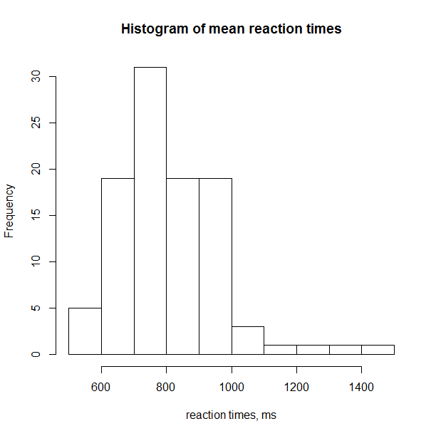

Slide 24
Outline
Measures of central tendency
Measures of dispersion
Graphical representations
Testing normality

Slide 25
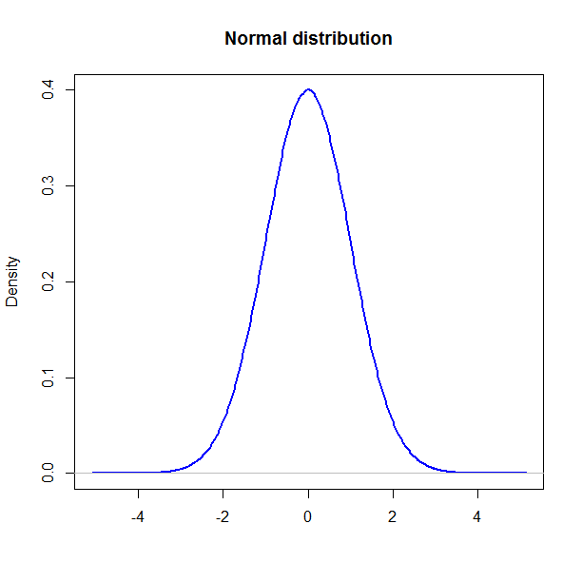
Normal distribution
A bell-shaped curve
Mean = median = mode

Slide 26
Why is it important?
Some tests require that the data should be normally distributed.
This is why one should learn how to test if the data are normally distributed.

Slide 27
Shapiro test
> shapiro.test(Mean_RT)
Shapiro-Wilk normality test
data: Mean_RT
W = 0.92006, p-value = 1.418e-05
A small p-value (less than 0.05) means that the assumption that the data are normally distributed can be rejected.

Slide 28
QQ-plot
> qqnorm(Mean_RT)
> qqline(Mean_RT)
The points should lie close to the line, which is not the case.

Slide 29
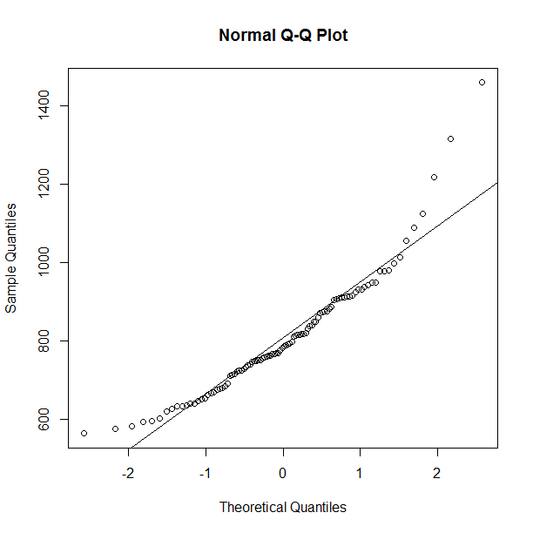

Slide 30
Another convenient function
> library(car)
> qqPlot(Mean_RT)
The plot displays a 95% confidence ‘envelope’ around the distribution. The points should be inside the envelope. If not, there’s a problem. The plot clearly shows that the three outliers with high scores are problematic.

Slide 31
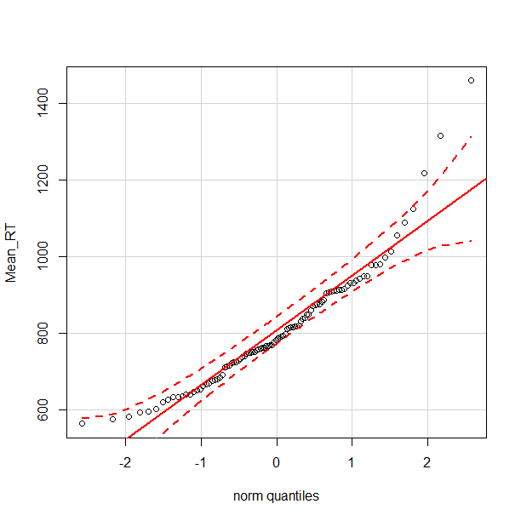

Slide 32
What to do with outliers?
If they represent errors, remove them.
If there are correct, one has several options:
Use a test which does not have a normality assumption (e.g. a non-parametric test).
Transform the variable (e.g. taking a logarithm).
Assign smaller values, e.g. based on the number of standard deviations from the mean.

Slide 33
Exercise
Remove the outliers:
> Mean_RT_new <- Mean_RT[Mean_RT < 1200]
> length(Mean_RT_new)
[1] 97
Perform diagnostics: does the new sample look more normally distributed?

Slide 34
Detach the data set
> detach(ldt) #if you stop working with it

